Slide 1
Willard and DiLoreto Hall
Renovation and Addition
2016-2018

Slide 2
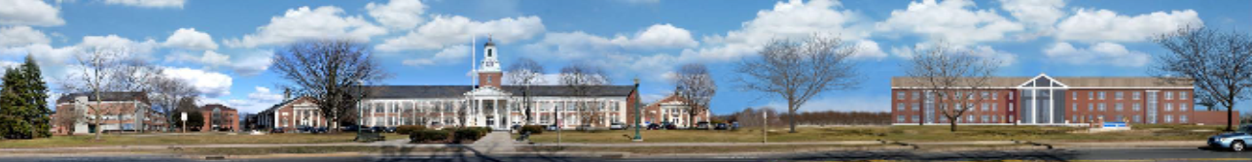

Exterior Elevation - West

Slide 3
Construction Cost: $54,000,000
Renovations to include:
  New Mechanicals
  New Windows
  New Elevators
  Updated Technology
  Code and ADA Compliance
  Renovated Classrooms
  Renovated Offices

Slide 4
Addition: 30,000 Square Feet
Grand Entrance
Student Service Circulation
Office Suites
Lounge
Roof Top Garden
Willard and DiLoreto building connection on all floors.

Slide 5
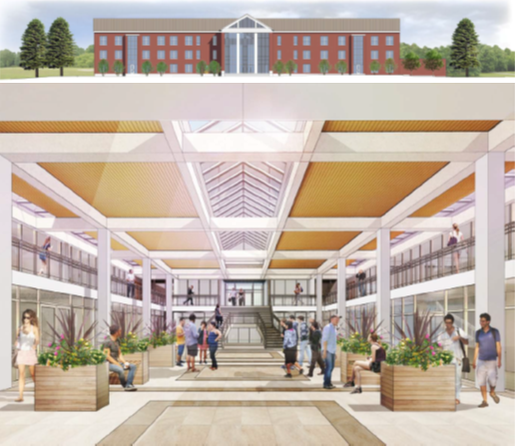
Willard and DiLoreto Hall

Slide 6
Occupants After Completion
The two-story "in-fill" will provide for the development of a new entrance, additional offices and updated classrooms. The building will house the following departments:
Modern Languages
Journalism
English
Counseling & Wellness Center
Student Conduct
Cultural Center
Women’s Center
LGBT Center
Bursar’s Office
Financial Aid
Registrar’s Office
Academic Articulation
Learning Center
Student Disability Services
Veterans Affairs
Violence Prevention
Center for Advising & Career Exploration
Carol A. Ammon College of Liberal Arts & Social Sciences
Promotion & Tenure
ConnCAP
Card Office

Slide 7
Number of Affected Classrooms
Willard Hall – Classrooms
  24 General Classrooms
  1 Lab
DiLoreto Hall – Classrooms
  9 General Classrooms
Total – 34 General Classrooms

Slide 8
Plan to Handle Impact
All available rooms will be used as classroom space.
Use downtown space.
Spread week out evenly.
Create additional teaching space on and off campus.

